Slide 1
GrizzTime - Sprint 2
Misael Hernandez, Melissa Palmer, Daniel Salar, Gurnirunjun Shergill, Anthony Robin

Slide 2
Sprint 2:
Setup MS Azure Remote SQL Database
Finalize creation of all entities in the database
User stories for this sprint:
As a business administrator, I can register an account for my business.
As a business administrator, I can modify my business.
As a project manager, I can create a new project.
As an employee, I can register my account under a business.
Began Implementation of bootstrap template
Created UI for user stories

Slide 3
MS Azure SQL Server
Benefits:
Allows easy implementation of object relational mapping with ASP.net MVC.
Enhanced Security
Server and database firewall configuration
Data encryption
Data masking

Slide 4
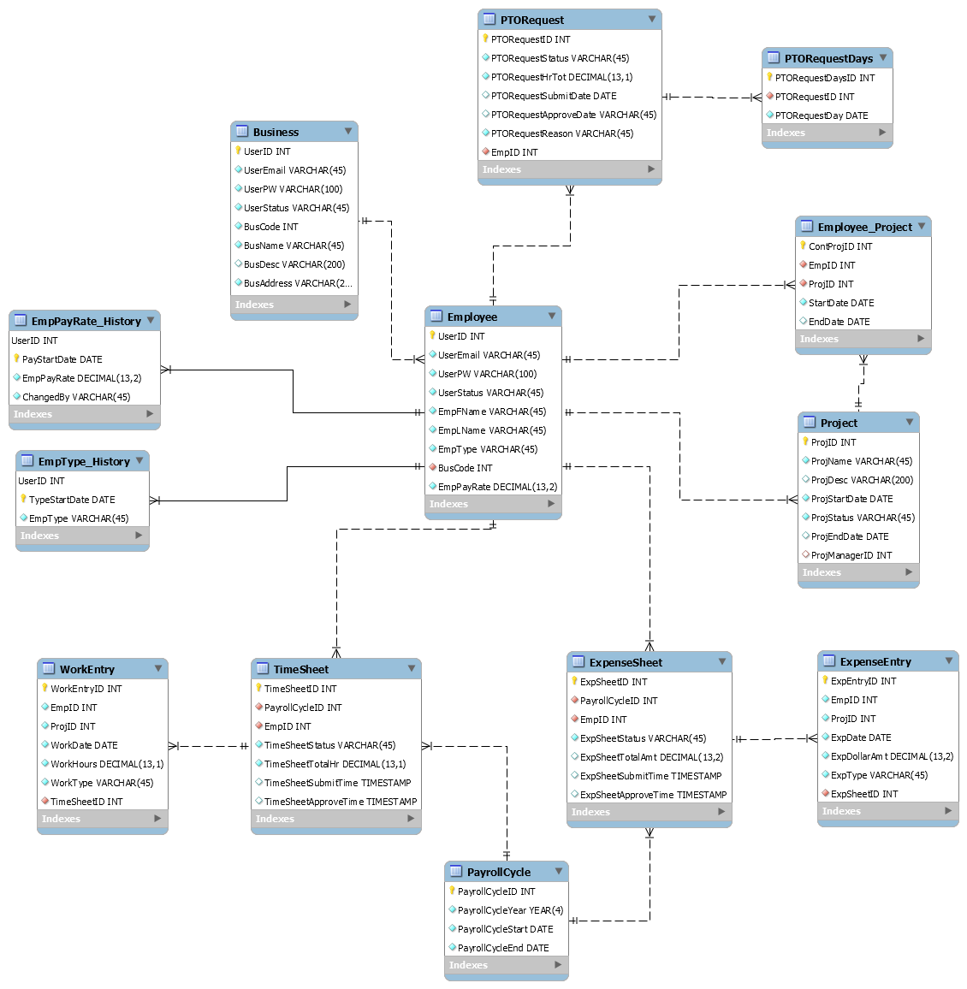
ER Diagram

Slide 5
Register Business Account
An account for a Business can be made:
A business code is given when this account is created
An employee can register under this business using the business code
Business accounts may create projects

Slide 6
Employee account
An employee can create an account under a business:
An employee can use a business code to register under a business

Slide 7
Challenges
Setting up access to SQL Server through MS Azure accounts
Modifications to Database structure required correcting the methods previously set up for a registration.

Slide 8
Next step
Sprint 3:
User stories for this sprint:
Employee management by business administrator
View all users registered to business, assign PM role
Contractor management by project manager
Add to project, assign/edit pay rates, remove from project
Project management by project manager
View details, edit details, mark as ended
Must complete all UI/UX for next sprint,
Must create all QA tests for business/projects

Slide 9
Thank you

